Slide 1
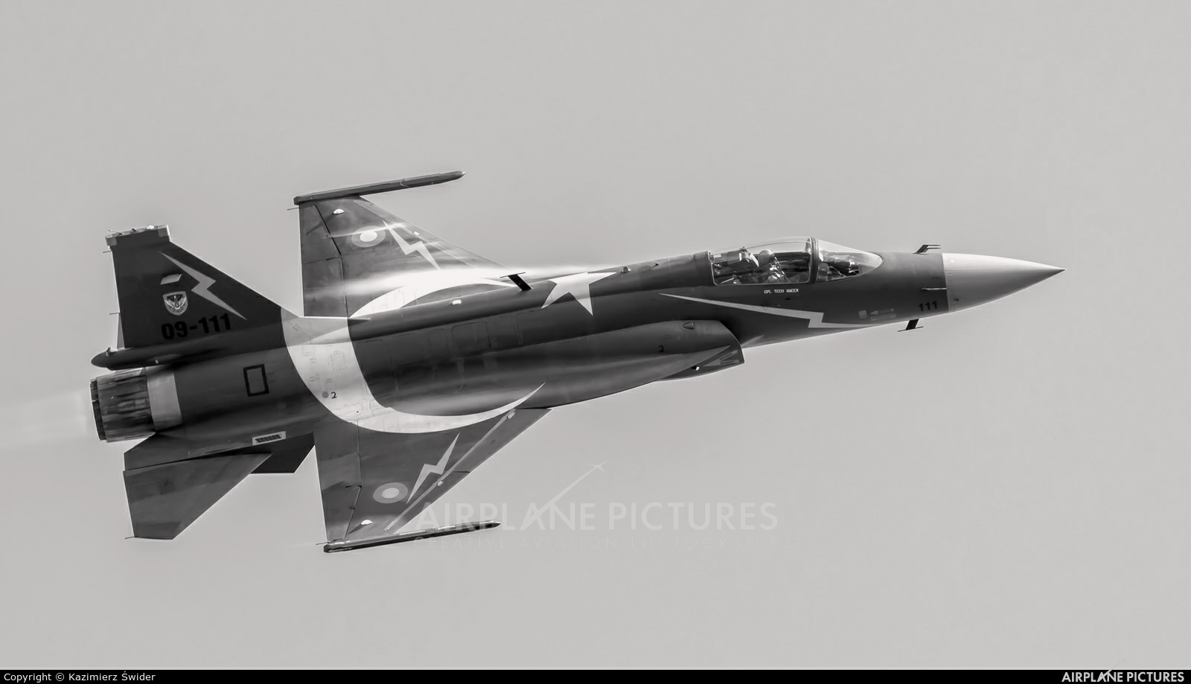
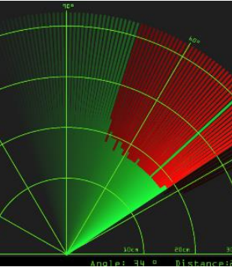
RADAR SYSTEM

Slide 2
Table of Contents
Introduction to Radar System
Components and their description
Block Diagram
Circuit Diagram
Working Principle
Applications

Slide 3
Introduction to Radar System
Radar is a long-range object detection system that uses radio waves to establish certain parameters of an object like its range, speed and position
The project is based on Sonar technology as I will be using an Ultrasonic Sensor to determine the presence of any object in a particular range.
Rader is an object detection system. It uses Microwaves to determine the range, altitude, direction, or speed of objects. The radar can transmit radio waves or microwaves which bounce off any object in their path. So, we can easily determine any object in the radar range.

Slide 4
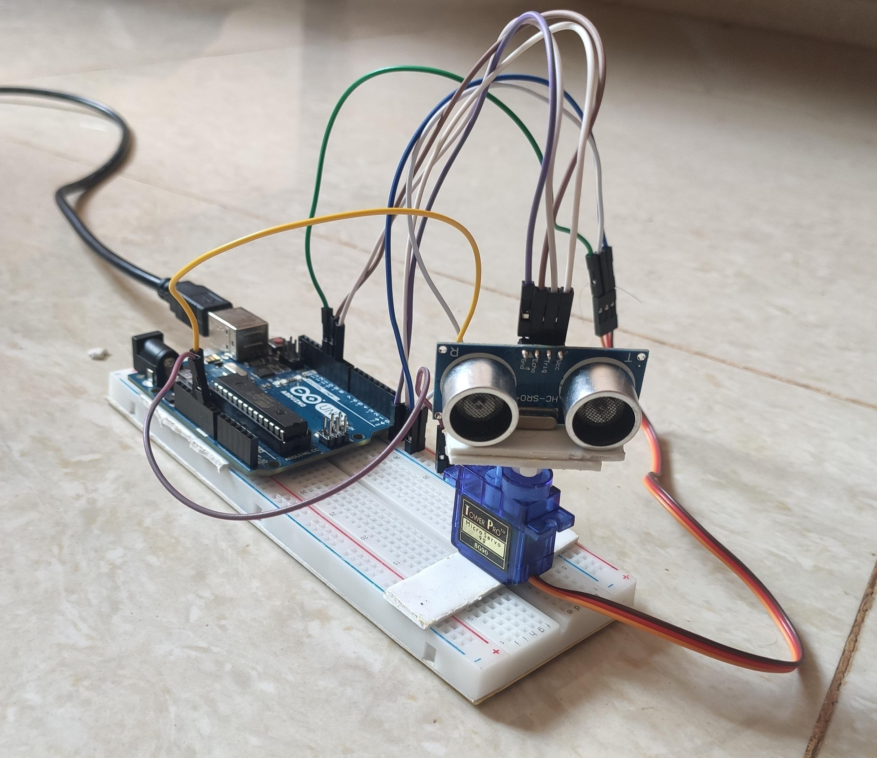

Slide 5
Components:
Hardware
Arduino UNO
HC-SR04 Ultrasonic Sensor
Tower Pro SG90 Servo Motor
Jumper Cables + USB Cable (for Arduino)
Software
Arduino IDE
Processing Application

Slide 6
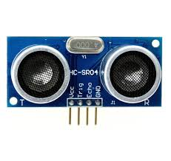
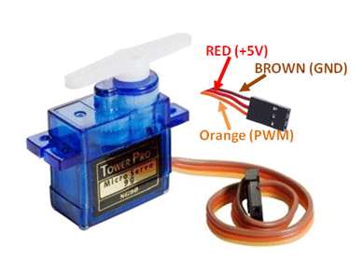
Ultrasonic Sensor:
Ultrasonic sensor is mainly used to determine the distance of the target object.
Transmitter and receiver are two main parts of the sensor where former converts an electrical signal to ultrasonic waves while later converts that ultrasonic signals back to electrical signals.
Its operating frequency is 4 MHz and its detection range is from 2cm to 400 cm.
Servo Motor:
Servo motor is a motor which requires +5V to operate and having a torque of 2.5kg/cm. It must be kept in mind that it can only rotate from 0°-180°.

Slide 7
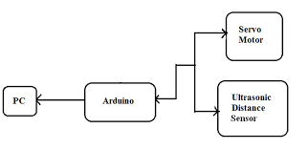
Block Diagram

Slide 8
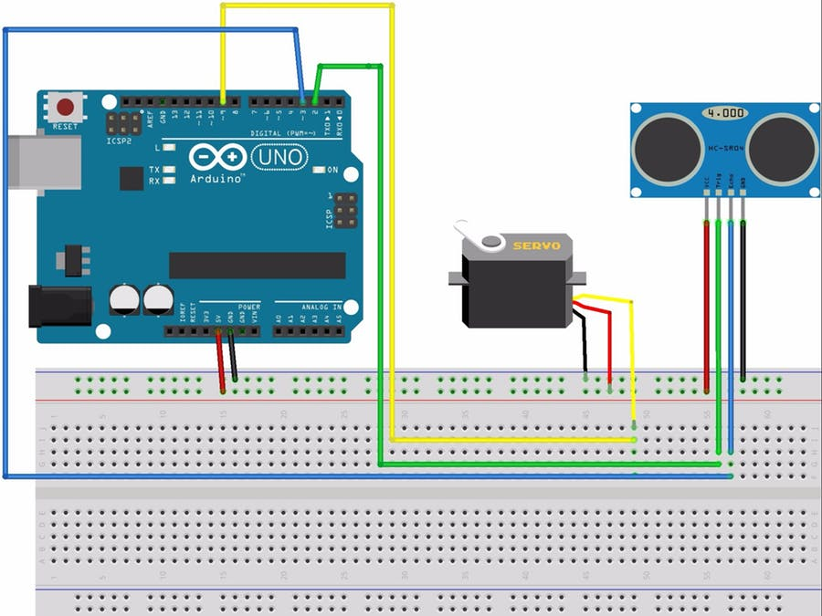
Circuit Diagram

Slide 9
Working Principle
The basic objective of our design is to ascertain the distance position and speed of the obstacle set at some distance from the sensor. Ultrasonic sensor sends the ultrasonic wave in various ways by rotating with help of servo motors. This wave goes in air and gets reflected back subsequent to striking some object. This wave is again detected by the sensor and its qualities is analyzed and output is shown in screen indicating parameters, for example, distance and position of object. Arduino IDE is utilized to compose code and transfer coding in Arduino and causes us to detect position or angle of servo motor and it is communicated through the serial port alongside the covered distance of the nearest object in its way.
Output of all of this working is shown in the software called processing, it will display the input/output and the range of the object.

Slide 10
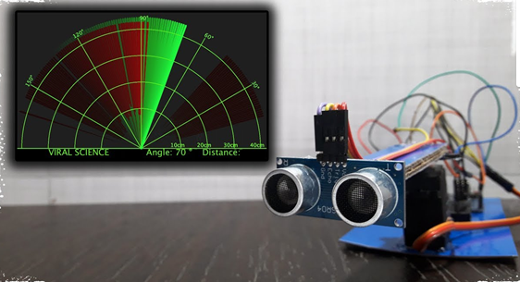
Implementations of the sensors are done in such a way that ultra-sonic sensor is attached on top of the servo motor because it have to detect the object and its distance. Arduino (micro-controller) will control the ultra-sonic sensor and servo motor and also powered will be given to both of them through micro-controller.
When any obstacle/object is detected by the ultrasonic sensor the data is immediately processed by the controller and is fed to the IDE which shows it on the display screen. Here the process ends with an estimated distance of the object from the system with the angle at which it is placed.

Slide 11
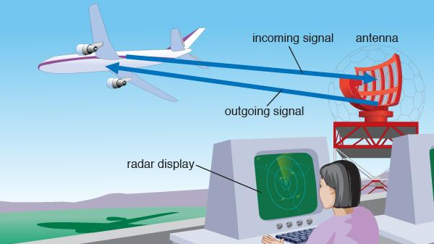

Slide 12
Applications
Radar is an electromagnetic system for the detection and location of target objects such as aircraft, ships, spacecraft, vehicles, people, and the natural environment which can reflect a signal back.
It uses electromagnetic radio waves to determine the angle, range, or velocity of objects
The modern radar system is more advanced and the uses of radar are highly diverse. Such as Air traffic control, Air-defence system, Radar Astronomy, Antimissile system, Ocean Surveillance system, outer space surveillance and many more.

Slide 13
Codes for project : https://drive.google.com/drive/folders/1qcoK5F0dOExUeTS4RI27dFwbEYQqduIO?usp=sharing

